Slide 1
Buffer Overflow Prevention
”\x31\xc0\x50\x68\x2f\x2f\x73\x68\x68\x2f\x62\x69\x6e \x89\xe3\x50\x53\x50\x54\x53\xb0\x3b\x50\xcd\x80”
Presented to CRAB
April 27, 2004

Slide 2
Outline
Buffer overflow review
Prevention overview
Randomized instruction sets
Address randomization
Solutions compared
Conclusion

Slide 3
What is a Buffer Overflow?
Intent
  Arbitrary code execution
    Spawn a remote shell or infect with worm/virus
  Denial of service
Steps
  Inject attack code into buffer
  Redirect control flow to attack code
  Execute attack code

Slide 4
Attack Possibilities
Targets
  Stack, heap, static area
  Parameter modification (non-pointer data)
    E.g., change parameters for existing call to exec()
Injected code vs. existing code
Absolute vs. relative address dependencies
Related Attacks
  Integer overflows, double-frees
  Format-string attacks

Slide 5
Typical Address Space
0xFFFFFFFF
kernel space
0xC0000000
argument 2
stack
argument 1
Address of
Attack code
shared library
RA
0x42000000
frame pointer
locals
heap
Attack code
bss
buffer
static data
code
0x08048000
0x00000000
From Dawn Song’s RISE: http://research.microsoft.com/projects/SWSecInstitute/slides/Song.ppt

Slide 6
Examples
(In)famous: Morris worm (1988)
  gets() in fingerd
Code Red (2001)
  MS IIS .ida vulnerability
Blaster (2003)
  MS DCOM RPC vulnerability
Mplayer URL heap allocation (2004)
  % mplayer http://`perl –e ‘print “\””x1024;’`

Slide 7
Preventing Buffer Overflows
Strategies
  Detect and remove vulnerabilities (best)
  Prevent code injection
  Detect code injection
  Prevent code execution
Stages of intervention
  Analyzing and compiling code
  Linking objects into executable
  Loading executable into memory
  Running executable

Slide 8
Preventing Buffer Overflows
Splint - Check array bounds and pointers
Non-executable stack
Stackguard – put canary before RA
Libsafe – replace vulnerable library functions
RAD – check RA against copy
Analyze call trace for abnormality
PointGuard – encrypt pointers
Binary diversity – change code to slow worm propagation
PAX – binary layout randomization by kernel
Randomize system call numbers

Slide 9
Preventing Buffer Overflows
Randomize code
  Barrantes, Ackley, Forrest, Palmer, Stefanovic, Zovi, “Randomized Instruction Set Emulation to Disrupt Binary Code Injection Attacks,” ACM CCS 2003.
Randomize location of code/data
  Bhatkar, DuVarney, Sekar, “Address Obfuscation: an Efficient Approach to Combat a Broad Range of Memory Error Exploits,” USENIX Security 2003.

Slide 10
Randomized Instruction Sets
Threat: binary code injection from network
Goal: de-standardize each system in an externally unobservable way
Solution:
  Each program has a different and secret instruction set
  Use translator to randomize instructions at load-time
Limits: no defense against data-only modifications

Slide 11
RISE: loading binary
Valgrind / RISE
Memory
Scrambled
Code
Key
ELF binary file
Code
+
Data
Data

Slide 12
RISE: executing code
Valgrind / RISE
Memory
Scrambled
Code
Key
+
Data
Hardware
Code

Slide 13
RISE: foreign code
Valgrind / RISE
Memory
Scrambled
Code
Key
Injected from network
Code
+
Data
Code
Hardware
SIGILL
Scrambled Code

Slide 14
Complications
Shared libraries
  Usually code from libraries is shared among multiple processes
  RISE scrambles shared code, at increased memory expense
Protecting plaintext
  Descrambled code blocks stored in trace cache
  Make cache read-only except when updating
Entanglement
  Should not use same libraries as process emulated
  Some libraries use dispatch tables stored in code

Slide 15
Performance
9 out of 14 attacks failed due to Valgrind itself
Others were stopped by RISE
RISE costs ~5% more than Valgrind (which is 4-50x slower than native)
Keeping “key” and shared libs triples memory
x86 opcode space is dense, so “random” instruction might not be illegal

Slide 16
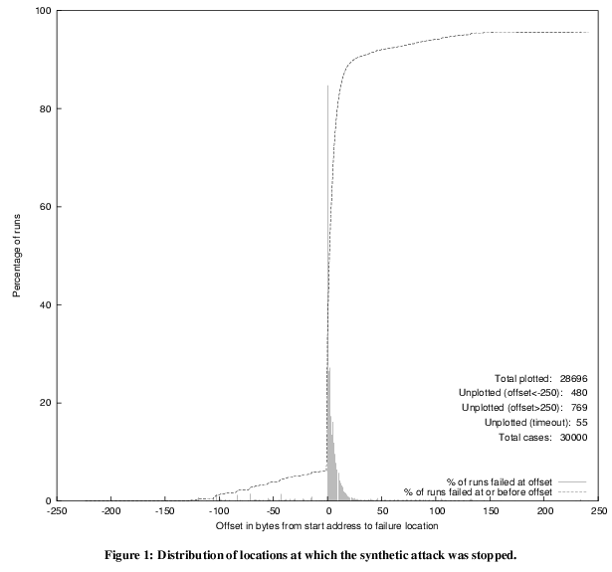
RISE: locations of crash
Percentage of runs
25%
6%
Offset from start address to failure location

Slide 17
Address Randomization
Threat: memory error exploits
Goal: remove predictability from memory access
Solution:
  Relocate memory regions
  Permute order of variables and code
  Introduce random gaps between objects
Limits: not all are easy to implement with common ABIs at load-time

Slide 18
Randomizing Obfuscations
kernel space
Randomize base addresses of memory regions
  Stack: subtract large value
  Heap: allocate large block
  DLLs: link with dummy lib
  Code/static data: convert to shared lib, or re-link at different address
Makes absolute address-dependent attacks harder
stack
shared library
heap
bss
static data
code

Slide 19
Randomizing Obfuscations
Permute the order of variables / routines
  Local variables in stack frame
  Order of static variables
  Order of routines in DLLs or executable
Makes relative-address dependent attacks harder
Not implemented by authors

Slide 20
Randomizing Obfuscations
Introduce random gaps between objects
  Randomly pad stack frames
    Between frame pointer and local variables
  Randomly pad successive malloc() calls
  Randomly pad between static variables
  Add gaps inside routines and jumps to skip them
Helps randomize objects which must maintain relative order
First two are implemented by authors

Slide 21
Performance
A probabilistic approach, increasing attacker’s expected work
Each failed attempt results in crash; at restart, randomization is different
~3000 attempts for P(success) = 0.5
0-21% overhead on execution time
Limited protection for:
  Modifications within heap-allocated blocks
  Overflows of adjacent data within stack frame or static variables

Slide 22
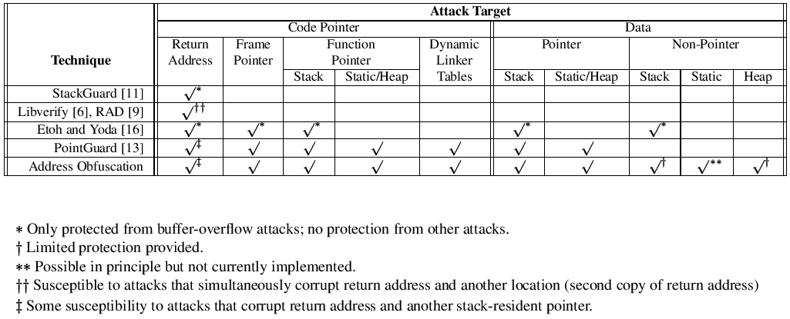
Comparison
RISE
x
x
x

Slide 23
Conclusion
Common weaknesses:
  Overflows onto adjacent data
  Read/write attacks
  Double-pointer attacks
  Lack of information at runtime
    Distinguishing pointers from non-pointers
    Determining sizes of data objects
    Distinguishing code from data
Static analysis + Link & Load-time randomization can be very effective (for now)

Slide 24
References
Barrantes, Ackley, Forrest, Palmer, Stefanovic, Zovi, “Randomized Instruction Set Emulation to Disrupt Binary Code Injection Attacks,” ACM CCS 2003.
Bhatkar, DuVarney, Sekar, “Address Obfuscation: an Efficient Approach to Combat a Broad Range of Memory Error Exploits,” USENIX Security 2003.
Cowan, Beattie, Johansen, Wagle, “PointGuard: Protecting Pointers From Buffer Overflow Vulnerabilities,” USENIX Security 2003.
Wilander, Kamkar, “A Comparison of Publicly Available Tools for Dynamic Buffer Overflow Prevention,” NDSS 2003.

